Slide 1
ROCKCLIMBING CLUBS.
EDEN,HARIN,AYVA.

Slide 2
QUESTIONS FOR THE SCHOOL CLUBS.
What do you do in this club?
THEY CLIMB WITH ROPES AND WITHOUT ROPES.

Slide 3
What day and time is the club?
The day is Tuesday and they start at 11:30.

Slide 4
What is fun in this club?
It’s when they fall down.

Slide 5
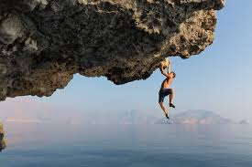
What is difficult in this club?
It’s when they are scared.

Slide 6
How many students come to this club?
There’s 18 students that come to this club.

Slide 7
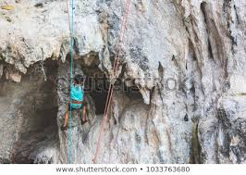
What is this goal for the club of the year?
The goal of this club is to make an effort.

Slide 8
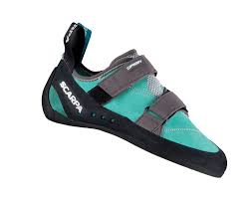
What equipement do we need to bring to this club?
We need shoes and socks.

Slide 9
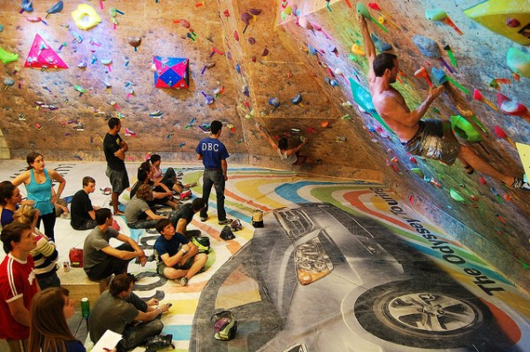
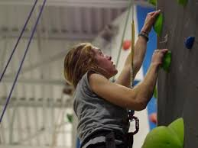
PICTURES OF ROCKCLIMBING.

