Slide 1
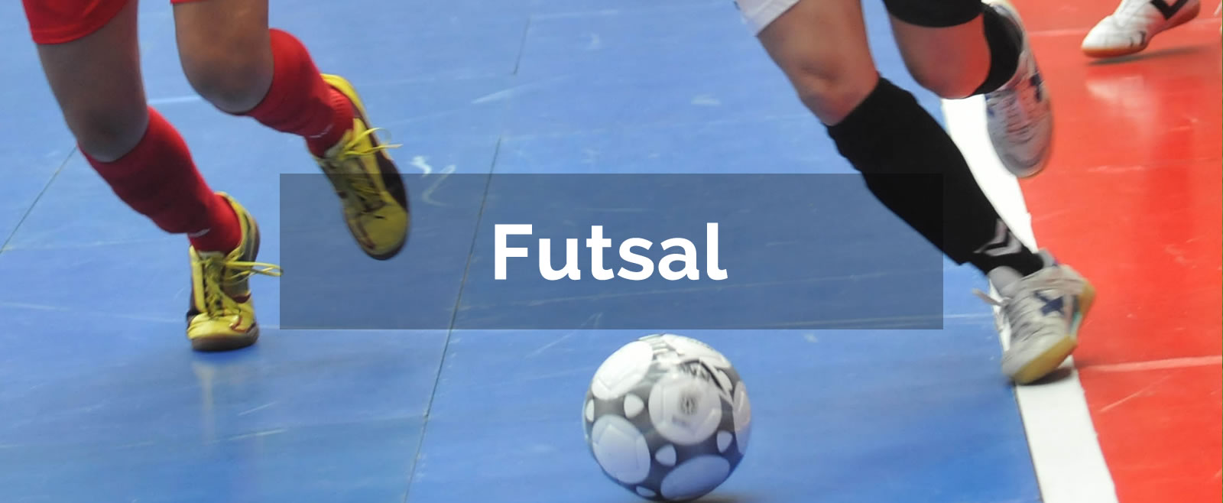

Slide 2
What do you do in this club?
We play futsal

Slide 3
What is fun in this club?
We play football with our friends

Slide 4
What day and time is this club?
Thursday 5pm to 7pm

Slide 5
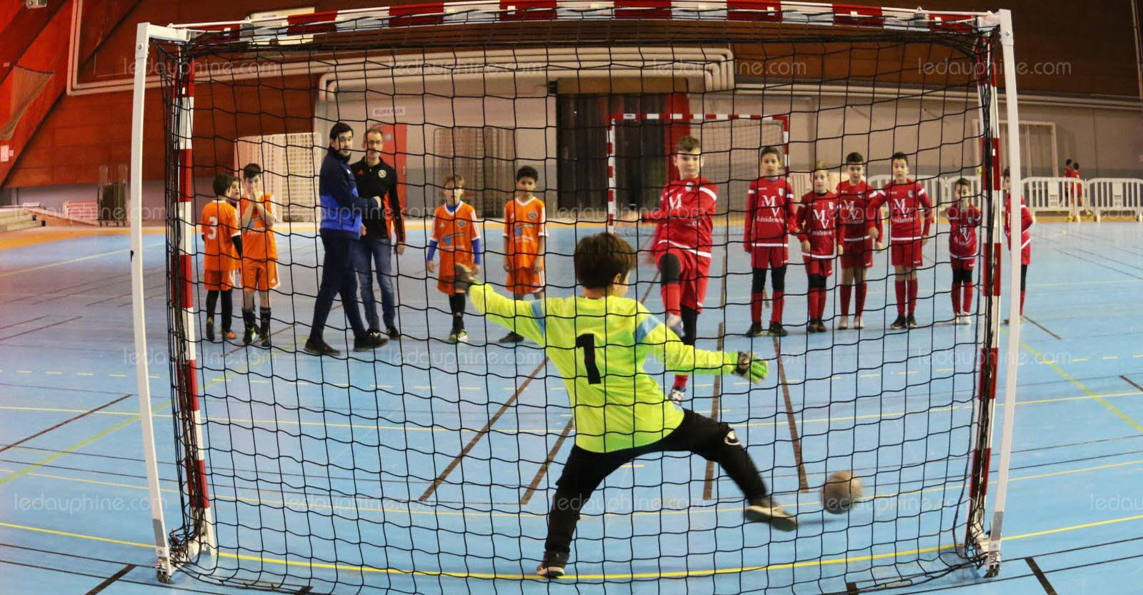
What is difficult in this club?
It’s to score the goals

Slide 6
How many students come to this club?
13 students come to this club

Slide 7
What equipement do we need to bring?
We must bring shoes

Slide 8
How can this club help me for school?
It can help me for sports

Slide 9
How much is the club fee?
It’s 1000 vt

